Slide 1

Title of the Project/Thesis
by
Student Name 4
Roll No. 204G1A32XX
Student Name 2
Roll No. 204G1A32XX
Student Name 1
Roll No. 204G1A32XX
Student Name 3
Roll No. 204G1A32XX
Under the guidance of
Mr. Xyz _{M. Tech.}
Assistant Professor
Department of Computer Science and Engineering (Data Science)
Srinivasa Ramanujan Institute of Technology
(Affiliated to JNTUA & Approved by AICTE) (Accredited by NAAC with ‘A’ Grade & Accredited by NBA (EEE, ECE & CSE)
Rotarypuram Village, B K Samudram Mandal, Ananthapuramu – 515701.
2023 - 2024

Slide 2
Abstract
The context or background information for your research
The general topic and specific research question or problem
The main objectives and goals of your research
The methods you used to conduct your research
The results or findings of your research
The conclusions or implications of your research
Note : The above points should be specified in an abstract using paragraphs
mostly 1 or 2

Slide 3

Contents
Abstract
Problem statement
Objectives of Project
Literature survey for first objective
Literature survey for second objective
Proposed Work -(Methods to be followed for proposed system)
References
GitHub Link
Queries

Slide 4
Introduction
Point 1
Point 2
Point 3
Point 4
Point 5
Point n

Slide 5
Existing System
Point 1
Point 2
Point 3
Point 4
Point 5
Point n

Slide 6
Proposed System
Point 1
Point 2
Point 3
Point 4
Point 5
Point n

Slide 7
Reference
[1]. Author 1, Author 2 and Author 3, “Title of the Paper”,” Journal name where the paper published, vol. 11, pp. 11-15, Jan. 2020.
Use Mendeley software

Slide 8
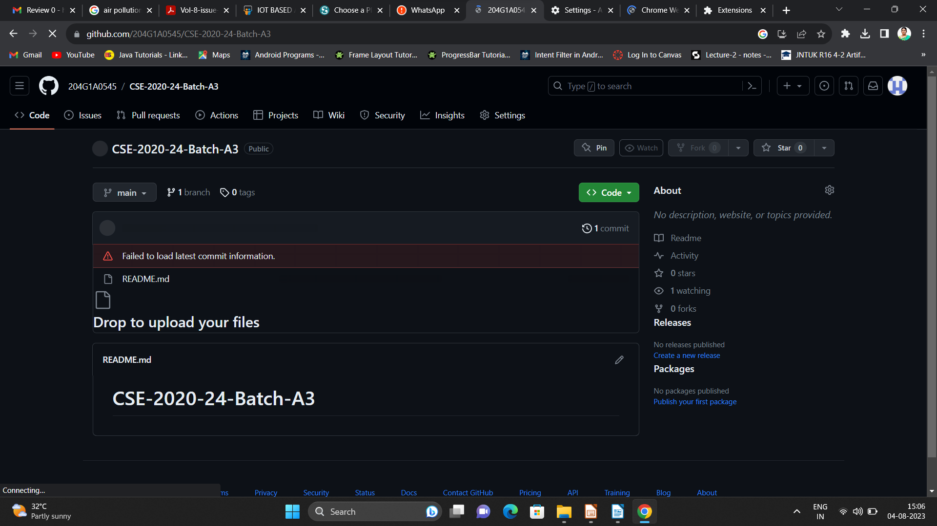

Git Hub Dashboards of each student
Repository Name Like: CSD 2023 – 24 Batch: A – XX
Under that project data upload literature survey papers, and son on..

Slide 9
Any Queries?

Slide 10
Thank You!!!

